Slide 1
Language Access: Know Your Rights
Presented by Ethiopian Community Center in partnership with DC Office of Human Rights

Slide 2
Language access is about justice and equality!

Slide 3
Language Access >>> Language Justice >>> Social Justice
Language Justice Overview (derived from Communities Creating Healthy Environments Language Justice Toolkit "Multilingual Strategies for Community Organizing")
Broadly language justice is about building and sustaining multilingual spaces in our communities, getherings, organizations and social movements so that everyone’s voice can be heard
Valuing language justice means recognizing the social and political dimensions of language and language access, while working to dismantle language barriers, equalize power dynamics, and build strong communities for social and racial justice.
Language justice is rooted in a history of resistance by communities and peoples whose voices and cultures have been suppressed for generations. Particularly as a response to a system of oppression based on language that results in structural advantages for dominant language (English) speakers and disadvantages for people who use non-dominant spoken and sign languages.
Language justice offers a vision of society that honors language and culture as fundamental human rights, and which does not settle for providing more people with access to the status quo, but rather alters institutions to provide space for full democratic participation
Language justice is critical in processes of organizing and advocating to achieve and exercise our rights because of and regardless of our race and language.
Notes:
Language access is an element of language justice

Slide 4
What is Language Access?

Slide 5
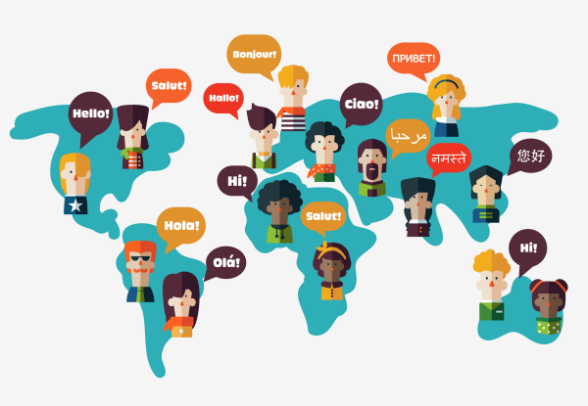
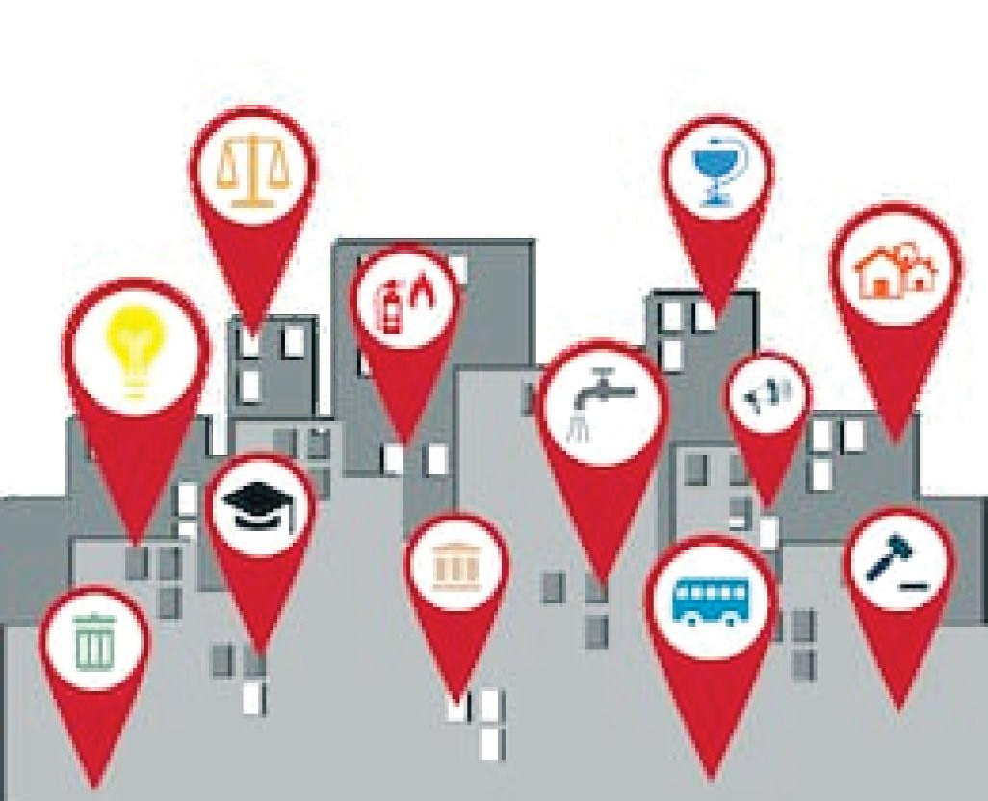
Language Access is realized when:
Language Access is universal!
a person who DOES NOT speak
English very well
Receives the same access to services
as a person who DOES speak
English very well.
Notes:
In the context of the country we are living in the dominant language is English
Access to all public services

Slide 6
Language Access is protected by law!
Title VI of the Civil Rights Act of 1964
Executive order 13166 of 2000
D.C. Language Access Act of 2004
D.C. Human Rights Act

Slide 7
Title VI, Civil Rights Act of 1964
No person in the United States shall, on the ground of race, color, or national origin, be excluded from participation in, be denied the benefits of, or be subjected to discrimination under any program or activity receiving Federal financial assistance.

Slide 8
Executive Order 13166 (2000)
“Improving Access to Services for Persons with Limited English Proficiency” (covers federally conducted agencies like the DOJ, DHS, HHS, SSA, etc.) & must provide guidance – www.lep.gov)

Slide 9
DC Language Access Act of 2004
The DC Language Access Act obligates the DC government to provide equal access and participation in public services, programs, and activities for residents of the District of Columbia who cannot (or have limited capacity to) speak, read, or write English.
These communities can also be referred to as limited-English proficient (LEP) and non-English proficient (NEP)
Notes:
It’s important to note the history of DCLAC and the community organizing and advocacy that pushed for the necessity of language access and that movement resulted in the enactment.

Slide 10
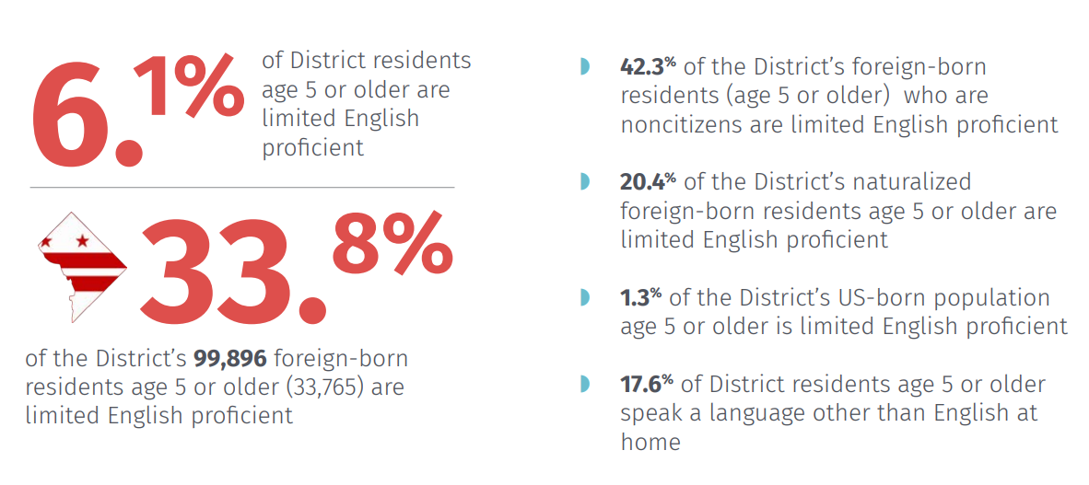
Why is the DC Language Access Act important?
Derived from OHR’s FY18 Language Access Annual Compliance Review

Slide 11
Why is Language Access important?

Slide 12
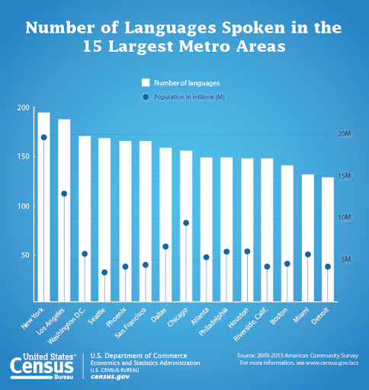
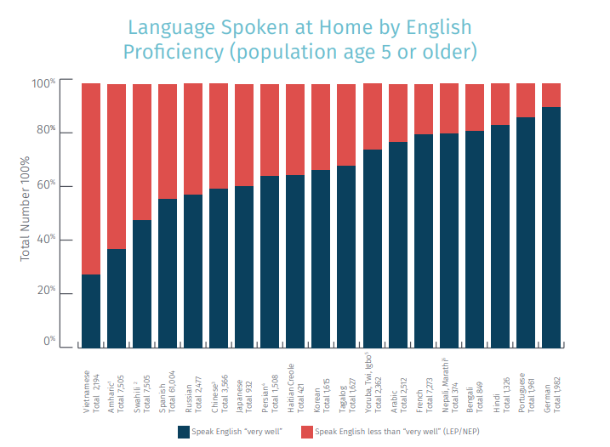

Slide 13
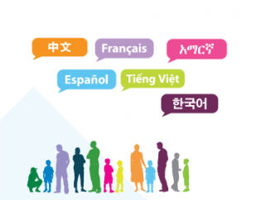
Languages most widely spoken in DC (other than English) :
Spanish
Chinese
Vietnamese
Korean
French
Amharic
Notes:
These six are the most widely spoken, so most likely all agencies will encounter these languages within the threshold (3% or 500 individuals)
Doesn’t mean other languages are ineligible under DC LAA

Slide 14
Language Access as a Right

Slide 15
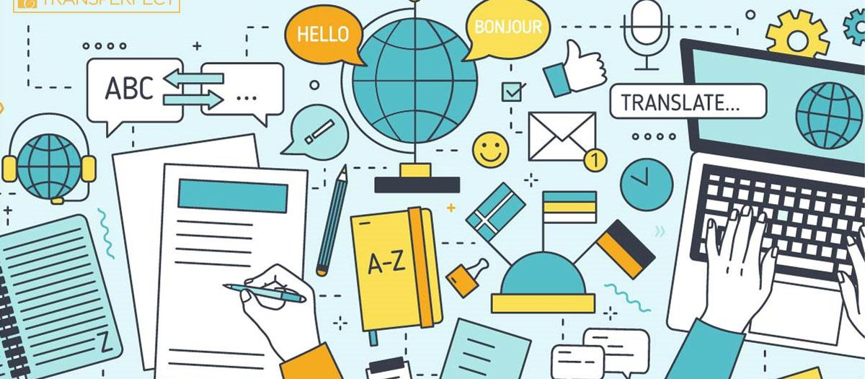
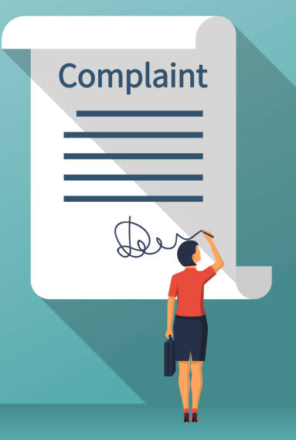
DC Language Access Rights
If you request a service within/from DC government agencies and you cannot speak, read, write or understand English, you have the right to:
Request and receive free interpreter services in your preferred language
Request and receive free translation of vital documents (including but not limited to applications, notices, consent forms, and letters in both print and electronic form) in your preferred language
File a complaint if denied these services at a DC government agency with the Office of Human Rights (OHR)

Slide 16
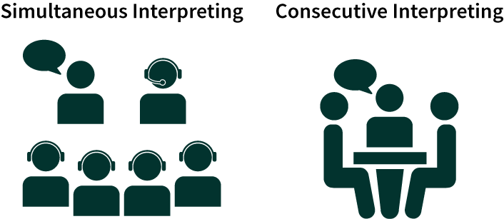
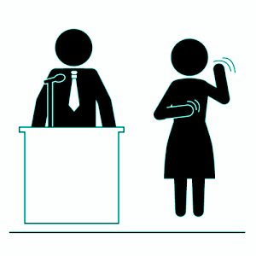
Language Access Tools: Interpretation vs Translation
Definitions derived from Alice Johnson’s handbook “Interpretation and Translation: Power Tools for Sharing Power in Grassroots Leadership Development.”
Sign Language Interpreting
Interpretation: The oral and/or sign language process of rendering a spoken message from one language into another.
Consecutive Interpretation: The speaker speaks a few sentences and then pauses to allow the interpreter to repeat them in the other language. The speaker and interpreter take turns talking.
Simultaneous Interpretation: The interpreter interprets the speaker’s message at the same time as the speaker is talking. Special audio transmitter equipment is required

Slide 17
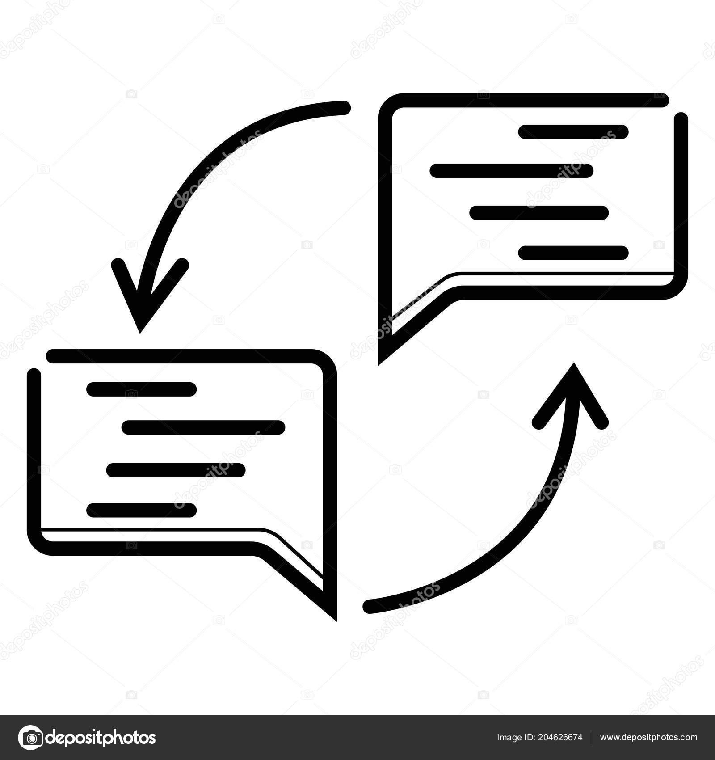
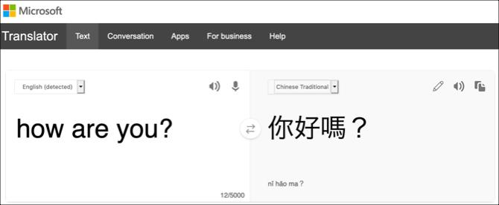
Language Access Tools: Interpretation vs Translation
Translation is the process of rendering a written document (printed or in digital form) from one language into another.

Slide 18
City Services and Language Access
DC Government Agencies (including most federal agencies)
DC Public Schools, Dept. Human Services, DCRA (permits), Hospitals (DOH), Dept. Motor Vehicles (DMV), WMATA (Metro), Public Works, etc.
All DC Courts, MPD and enforcement agencies
.
Organizations that receive funds /contracts with the D.C. government
Upper Cardozo Health Center, La Clinica del Pueblo, Mary’s Center, CentroNia, Community gardens, Neighbors Consejo, etc.
Legal service providers and victim service providers (that receive federal or local funding)
Ayuda, Break the Cycle, Bread for the City, Catholic Charities, Legal Aid Society, etc.
.

Slide 19
Look for signs of Language Access
“I Speak” Cards
Signages and posters
Language Line ID Cards

Slide 20
When you visit city agencies look for translation/interpretation signs or notes.
Request to use the language line/phone interpretation if there are no qualified interpreters or bilingual staff on site
You can complain if you are not offered any form of Language Access

Slide 21
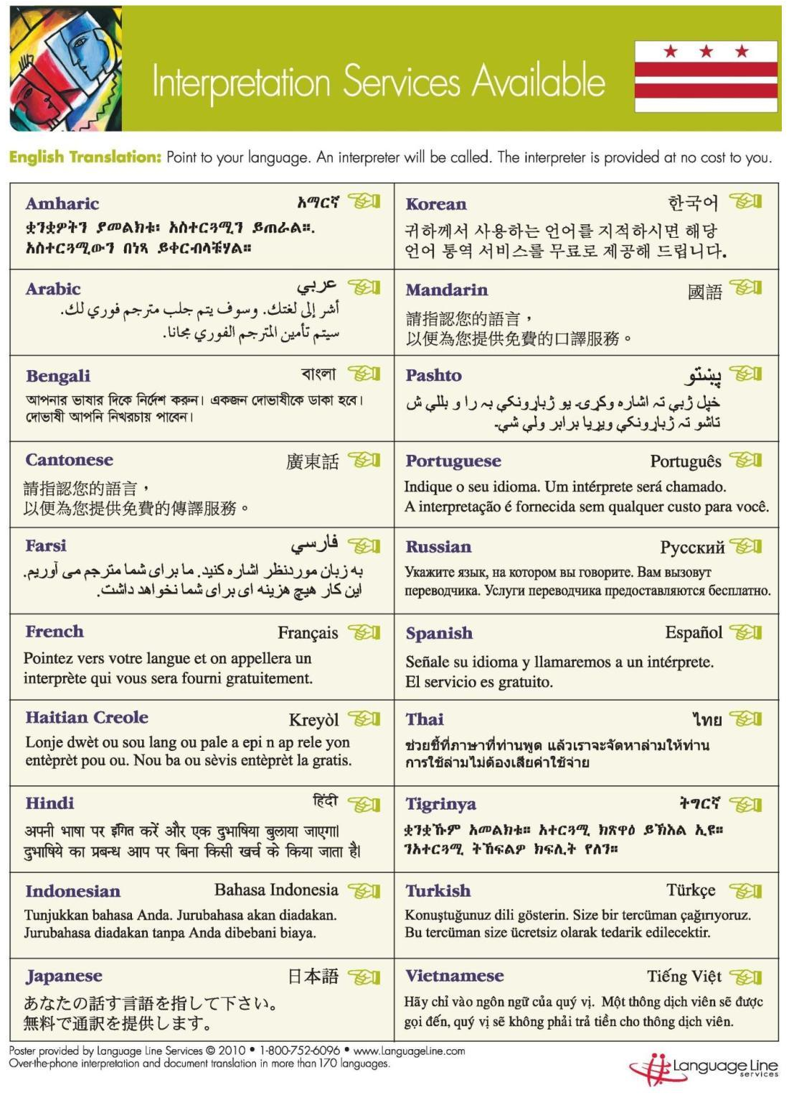
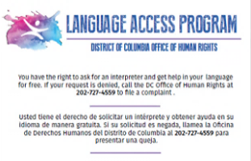
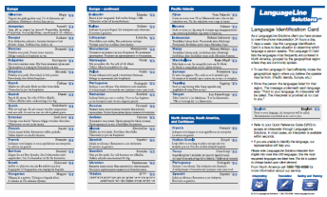

Slide 22
When you enter a DC Gov. Agency, employees of covered entities are expected to:
Greet you appropriately
Be prepared to assist you (trained on language access)
Use tools/resources to identify the language being spoken
Remain calm, patient and professional at all times
Provide assistance to you in the order which you arrived
Use translation or interpretation resources to respond appropriately to you and your needs

Slide 23
Language Access in times of Emergency

Slide 25
COVID-19 Resources in multiple languages:
DC Mayor’s Coronavirus page: https://coronavirus.dc.gov/
Ethiopian Community Center COVID-19 Resources page: https://www.ethiopiancommunitydc.org/covid19-resources
Food Access, Unemployment Insurance and PUA, DCPS resources, etc
Fresh Produce distribution at Mariam Church (1350 Buchanan St NW) every Friday at 12:00pm - 202-726-4115
CDC Print Resources in Various Languages
Washington DC Domestic Violence Court Forms
A Round-Up of Multilingual Resources on COVID-19

Slide 26
Filing a Language Access Complaint
Keeps a record and complaints make the law work for us
Complaints can produce meaningful changes in how the government serves us

Slide 27
Who can file complaints and who reviews it?
Any resident of the district can file a Language Access complaint, especially of covered agencies (entities)
Covered entities: The Act designates 39 agencies as covered entities with major public contact and constitutes a threshold of 3% or 500 individuals (whichever is less) of the population served or encountered or likely to be served or encountered by the entity.
DC Office of Human Rights is in charge of reviewing and addressing the complaint
You can get assistance to help you file a complaint:
Asian Pacific American Legal Resource Center:
(202) 706-7102
Mandarin/Cantonese, Vietnamese
The Legal Aid Society of DC: (202) 628-1161
Spanish, Amharic
Ethiopian Community Center: (202) 670-6271
info@ethiopiancommunitydc.org
Amharic
Bread for the City: (202) 265-2400
Spanish, Amharic
Mayor’s offices Language Access agencies:
MOLA, MOAPIA, MOAA
All languages
Office of Human Rights : (202) 727-4559
https://ohr.dc.gov/webform/language-access-public-complaint-form

Slide 28
Transition
Rosa Carillo
Language Access Director
DC Office of Human Rights

Slide 32
Review and Resources

Slide 33
When you go to a government agency or to a community service (REC Center/hospital) that receives city government funding.
What can you show a government or community organization employee to tell them you need an interpreter?
An apple
point to a language access sign
“I speak” card
A thermometer

Slide 34
If English is not your native language and/or you do not speak it well.
What must you receive/be offered when you enter a DC government agency (school, recreation center, pool, garden)?
An advice to learn English
Free translation of vital documents
Free interpretation (language line)
a pencil

Slide 35
If you need to get an driver license or need SNAP food assistance for your children. Or you need to register your business, or pay a parking ticket.
What can you do if you do not receive the language access services you need?
comeback with friend or ask your child to interpret
Submit a complaint! (you can also get help to do this)

Slide 36
Ethiopian Community Center DC
የዲሲ የኢትዮጵያ ማህበረሰብ ማዕከል
Website | ድህረ ገጻችን (ዌብሳይት): https://www.ethiopiancommunitydc.org/
For general support, concerns and questions you may have, please | ለአጠቃላይ ድጋፍና መረጃ፣ ሊኖርዎ ለሚችሉት ስጋቶች እና ጥያቄዎች እባክዎን በ፦
Email: info@ethiopiancommunitydc.org ኢሜል ይላኩልን
or
send us a message on Facebook | ወይም በፌስቡክ መልዕክት ይላኩልን
EthiopianCommunityDC
Call/Text | ይደውሉልን ወይም ቴክስት ያርጉ:
(202) 670-6271

Slide 37
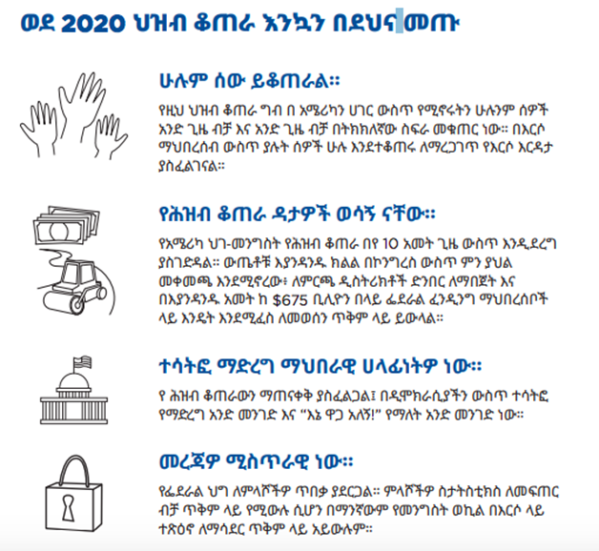
2020 Census
የ2020 ሕዝብ ቆጠራ
You can self-respond to Census 2020 online at | ከቤትዎ ሆነው የ2020 ሕዝብ ቆጠራን ቅጽ ኦንላይን መሙላት ይችላሉ፦
www.my2020census.gov
For a step-by-step guide to the Census Form in Amharic see videos here | በአማርኛ የተዘጋጀ የ2020 ሕዝብ ቆጠራ ቅፅ ቪድዮ መመሪያ ለማየት:
https://www.ethiopiancommunitydc.org/videos-and-webinars

Slide 38
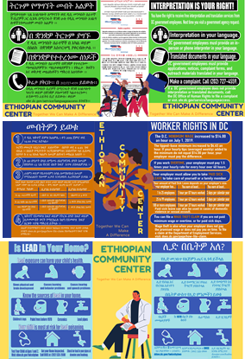
Community Support
ለማህበረሰባችን የምንሰጠው ድጋፍ
https://www.ethiopiancommunitydc.org/support-for-communities
Language access is your right! If you have been denied, you have the right to file a complaint with the DC Office of Human Rights. | በሚግባቡበት ቋንቋ ትርጉም ማግኘት መብትዎ ነው። ይህ መብትዎ ተጥሶ እንደሆነ፣ ለዲሲ የሰብአዊ መብቶች ቢሮ አቤቱታ የማቅረብ መብት አልዎት።
Know your rights as a worker in DC. You can file a wage theft claim with the Department of Employment Services if you are not paid minimum wage or overtime, or for paid sick days. | ዲሲ የሚሰሩ ከሆነ መብቶችዎን በሚገባ ይወቁ። አሰሪዎ ዝቅተኛ ደሞዝ፣ የተጨማሪ ሰዓት ክፍያ ወይም ለታመሙበት ቀናት የማይከፈሉ ከሆነ የደመወዝ ክፍያ ስርቆት ጥያቄ ማቅረብ ይችላሉ።
Lead is a health risk and learn how to prevent lead poisoning. To learn more visit Department of Environment and Energy's website for more information | ሊድ ለጤና አደገኛ ነው። መረጃዎቻችን እና ድጋፋችን ቤተሰብዎን በሊድ ከመመረዝ እንዴት መከላከል እንደሚችሉ የበለጠ ለማወቅ ይረዳዎታል።

Slide 39
Language Justice is the right to access and communicate in our own language.
“Sanctuary includes Language Justice”
Thank you!

Slide 40
Questions and Comments

